Slide 1
July and August Severe Weather
SEOC/Municipality Interaction during Activation
After Action Meeting

Slide 2
What's the Point of Tonight?
Improvements
Strengths
Missing or update what is known from the survey
**This will cover your interactions with the SEOC and your Local Liaisons-you should also debrief in your own agencies/jurisdictions

Slide 3
Feedback N=39
Municipalities
Albany
Barre City
Barton
Belvidere
Bethel
Brandon
Bristol
Brookline
Buel’s Gore
Burke
North Bennington*
Northfield
Panton
Plymouth
Royalton
Rupert
Stamford*
Tunbridge
Waterville
West Fairlee
Wheelock
Wilmington
Cambridge
Castleton
Chelsea
Chittenden
Cornwall
Ferrisburgh
Guilford
Hancock
Highgate
Hyde Park
Lincoln
Marshfield
Moretown

Slide 4
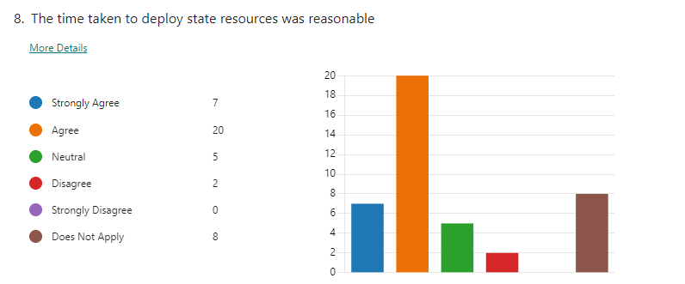

Slide 5
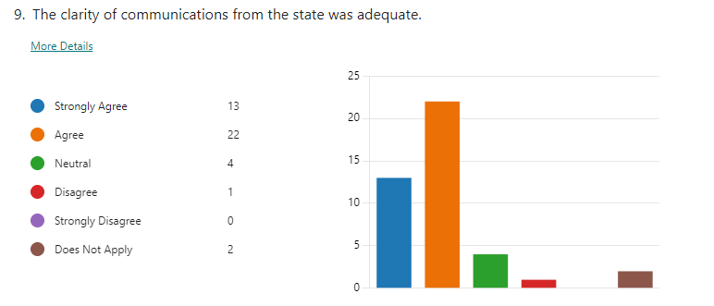

Slide 6
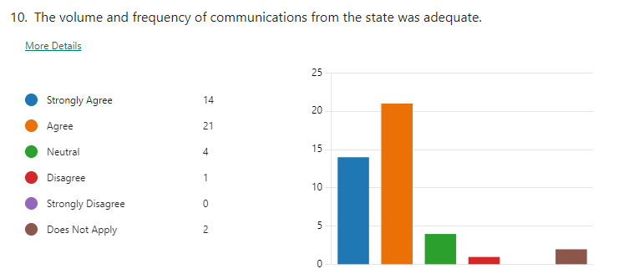

Slide 7
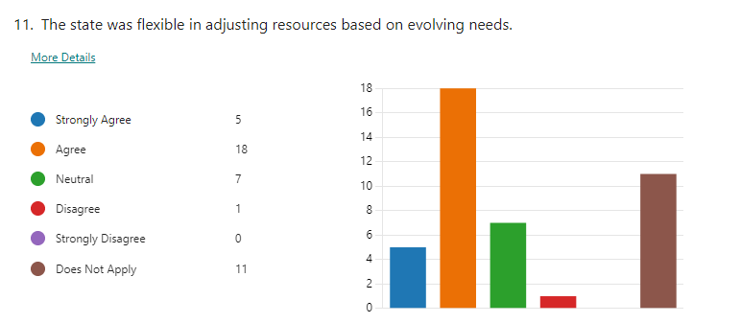

Slide 8
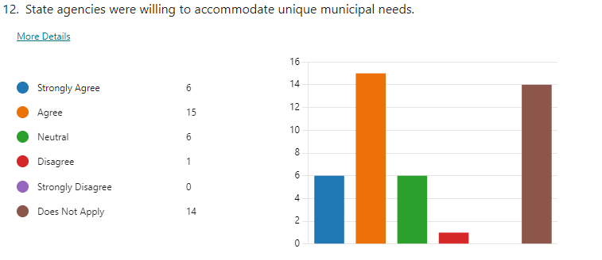

Slide 9
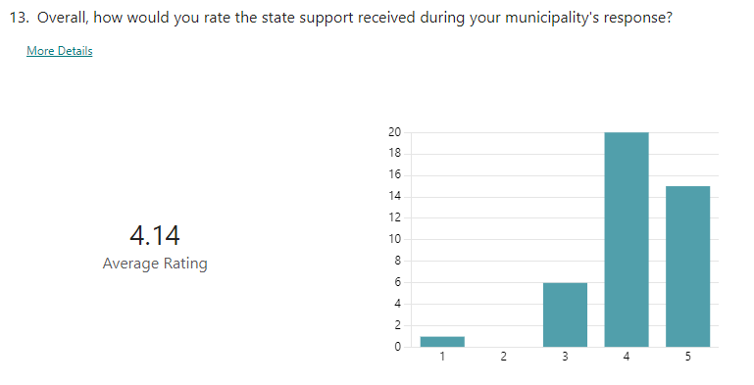

Slide 10
Summary of Areas of Strength
Use of technology reaching out to the municipalities
Responsiveness to needs of local responders
After a bit of trial and error at the beginning, I think the SEOC really fine-tuned their Statewide Briefings so that they were tailored and valuable to municipalities
Dam folks stayed overnight and kept EMDs up to date with information.

Slide 11
Summary of Area of Improvements
Some communications from the State were slow-example debris
Towns were not aware that some resources were billable.
Better use of mutual aid groups formed in towns across Vermont
Seems to be a disconnect between EMDs and their local schools in some areas
Coordination between USACE to support EMDs with response-especially for dam safety-Ball dam for example

Slide 12
Summary of Areas of Improvements
6. Some jurisdictions reported calling the SEOC asking for support but did not hear back
7. Recovery Transition - towns and cities needed the SEOC to transition to recovery much earlier than it did
8. SEOC should have a VTAC/UTAC Channel that is constantly monitored that towns can use to communicate with the state if their communications go down

Slide 13
Summary of Areas of Improvements
9. A ticket was closed out, but no action was taken. Town didn't hear back and when they called back weeks later, they were told the ticket was closed
10. Concern about miscommunication about fixing roads - town was told to only rough in road, they did that, and then were told they could have made full repairs instead
11. Concerns about having so many different FEMA people involved in the town for different specialized areas. Town noted they met with a bunch of different people, none of them seemed to be talking, so they had the same meeting over and over

Slide 14
Summary of Areas of Improvements
12. Local resident suggestion to have alarms associated with river levels
13. We need to find a source for generator grants (purchasing, installing, and/or elevating) and all band radios for communities. Suggestion that we lobby the legislature to find these funds.
14. Suggestion that satellite phones be strategically placed throughout the state in locations that are typically "islands" during disasters.
15. Would prefer 2-1-1 data nightly to be used effectively used

Slide 15
Discussion:
What's missing?
EMD mutual aid agreements?
Regional EOCs?

Slide 16
Next Steps
Direct line of communication to SEOC
WebEOC training for EMDs
Calais cannot reach 211-with A T and T-use whole phone number
Moretown residents flooded but didn't hear at the EMD
Add EMD numbers and website to messaging or the town hall
More emphasis on local versus regional sheltering-get ARC sheltering class in Central Vermont

Slide 17
Wayze
No mention of permitting from FEMA
Give folks an estimation of FEMA folks that will visit them
EMD handbook is GREAT!

Slide 18
Questions?

