Slide 1
Updating Municipal Housing Regulations

Slide 2
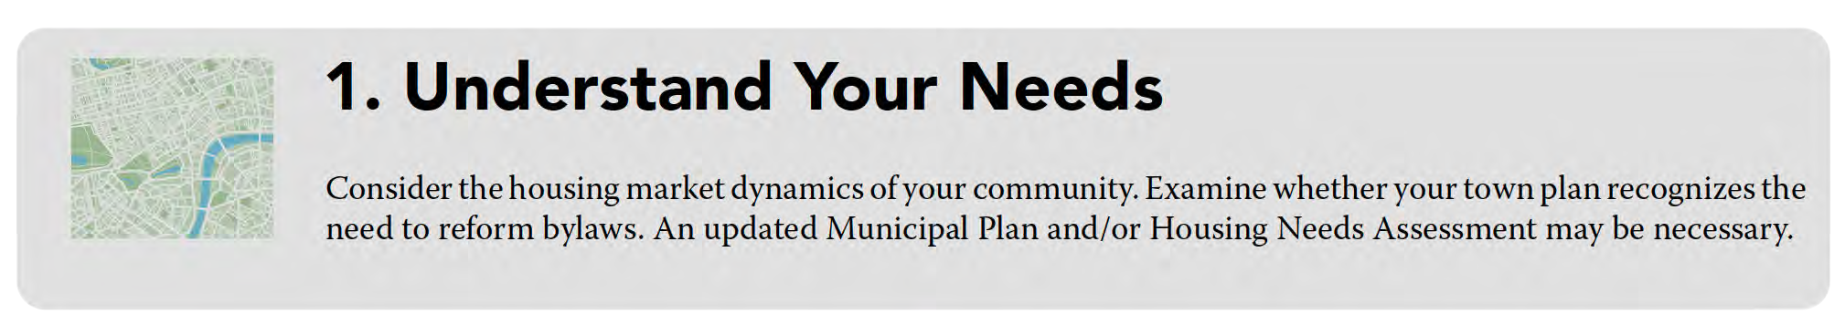
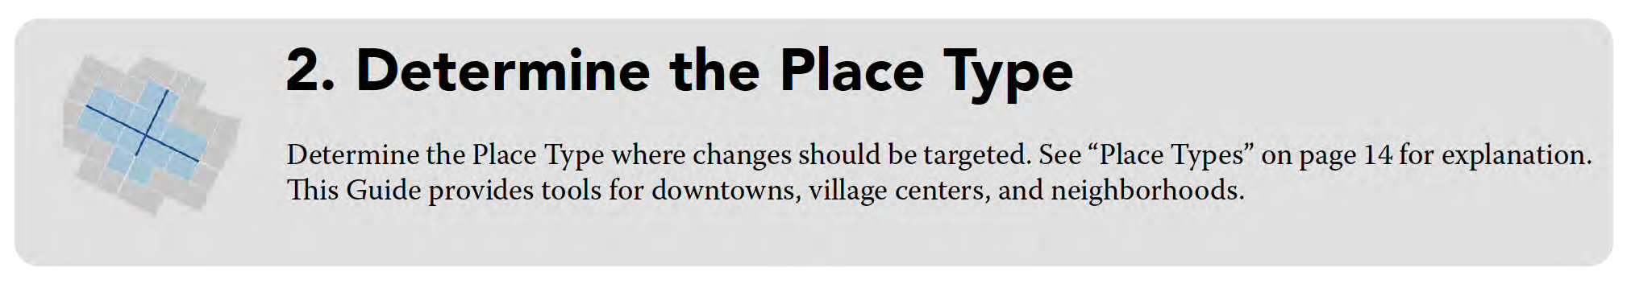

Slide 3
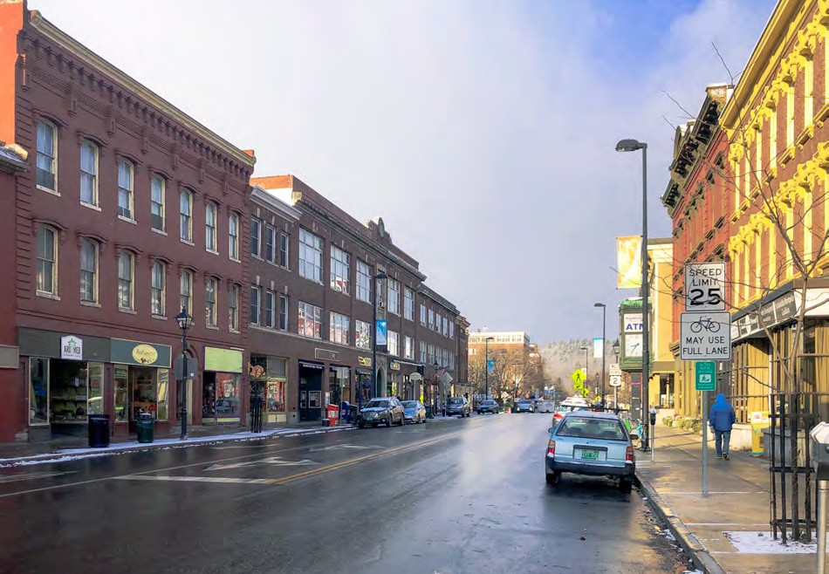

Types of Places
Context | Urban
Montpelier, VT: Susan Henderson
Stowe, VT: stock.adobe.com
Downtowns
Village Centers

Slide 4
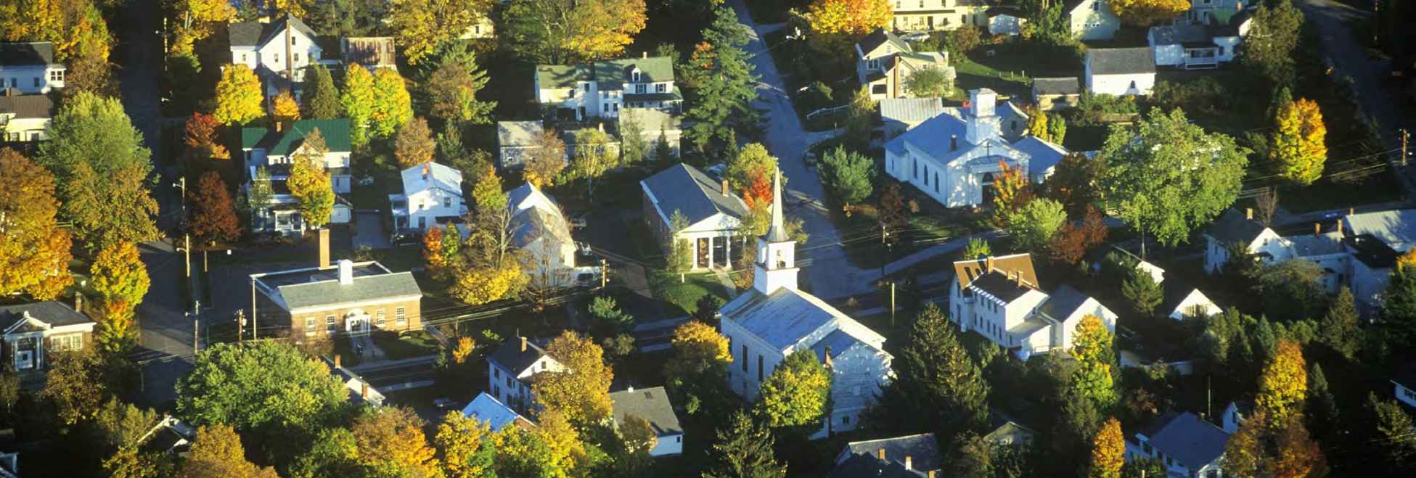
Types of Places
Context | Urban
Morrisville, VT: stock.adobe.com
Neighborhoods

Slide 5
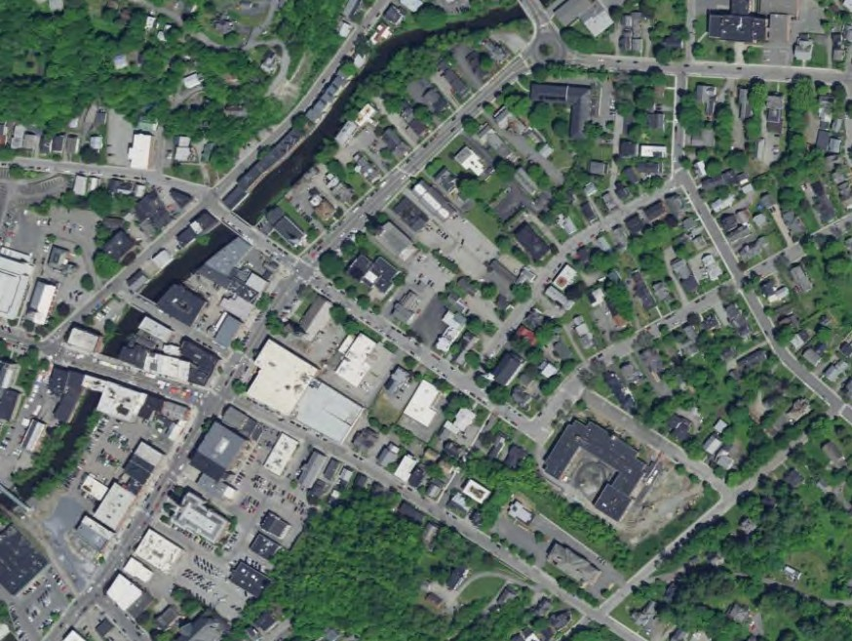
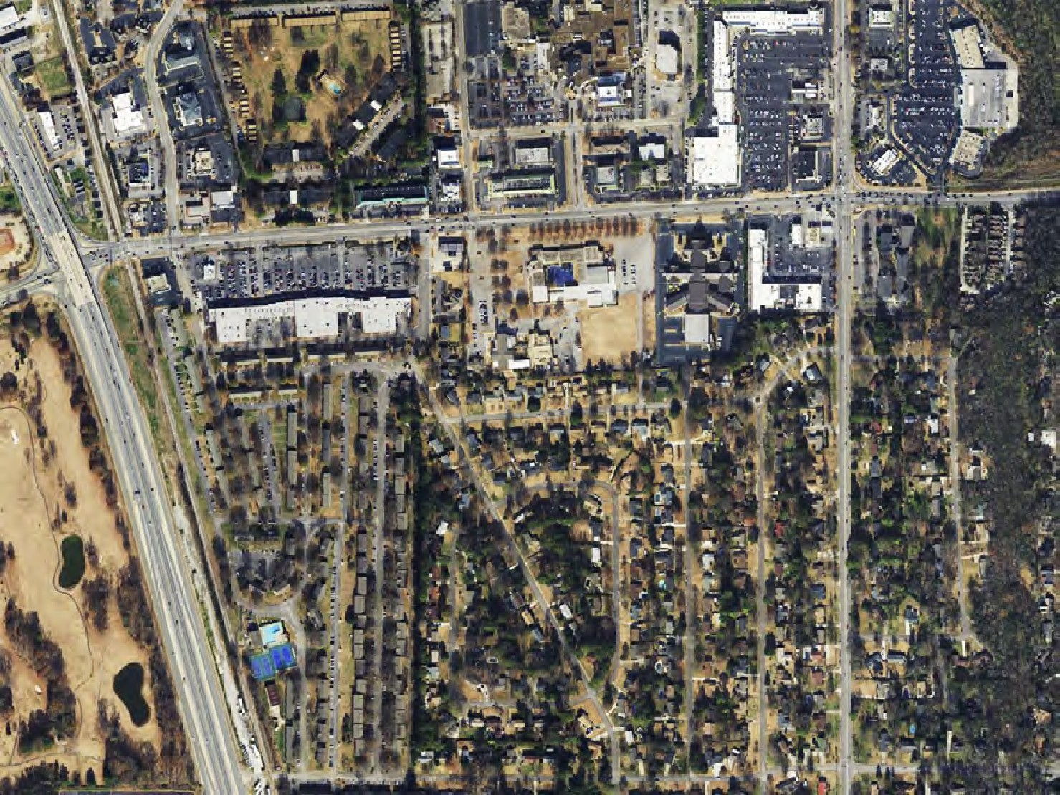
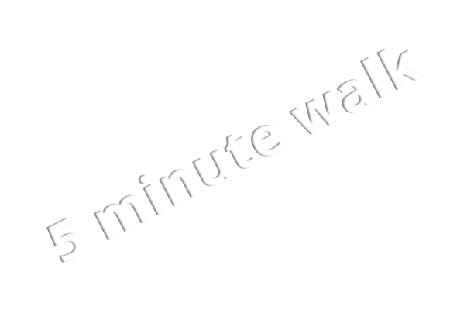
Neighborhoods
5 minute walk
Montpelier, VT: Apple Maps
Huntsville, AL: Apple Maps

Slide 6
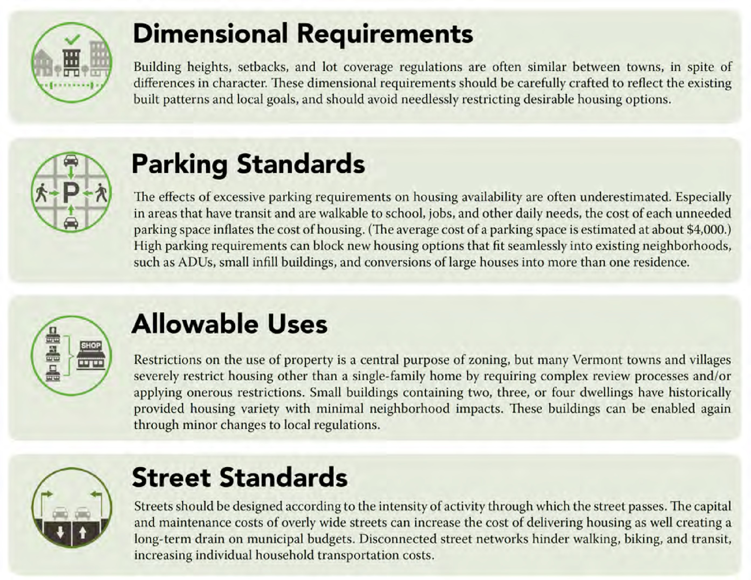
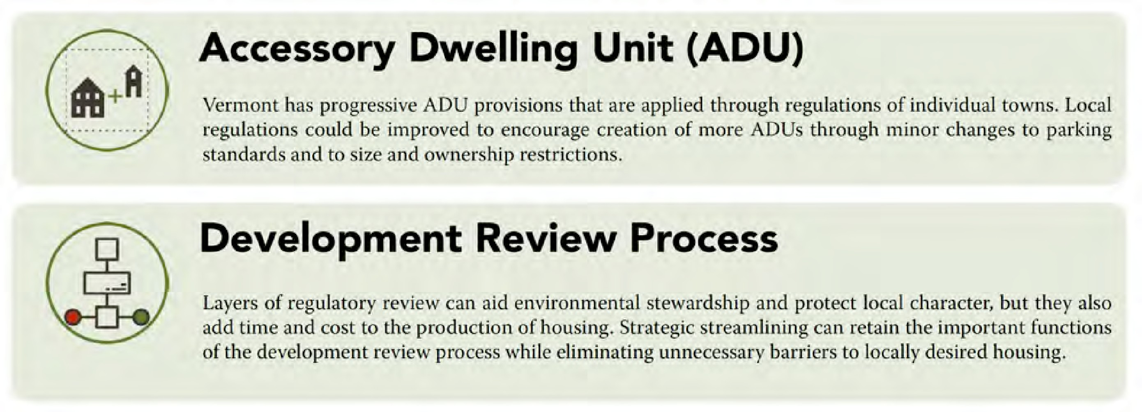

Slide 7
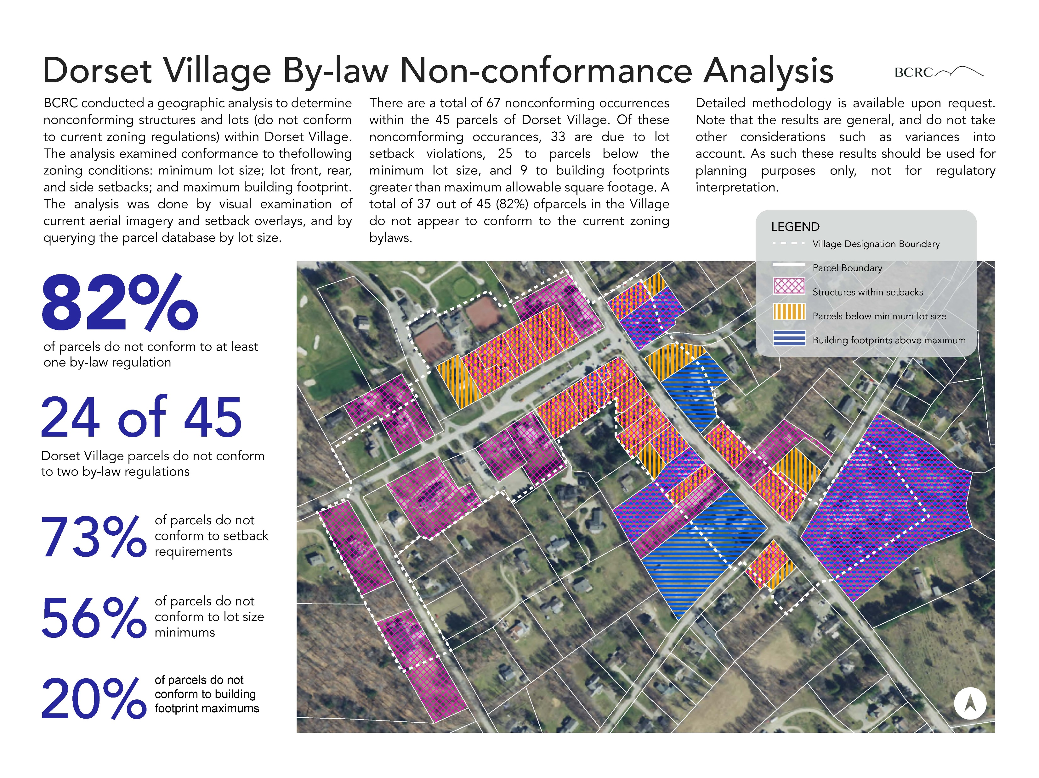
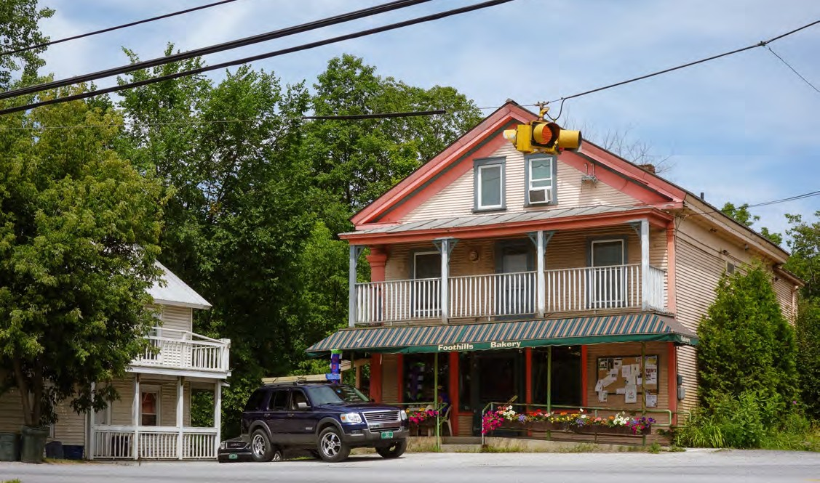
Dimensional Requirements
Match dimensional requirements to existing conditions.
Density restrictions based on building(s) instead of individual units/uses.
  Base density on water/sewer capacity, lot coverage, max units/building (instead of units/lot area).
Permit secondary principal buildings.
Remove unnecessary architectural requirements, but do consider context-based standards.
Innovative standards such as maximum front setback, façade orientation, and windows.

Slide 8
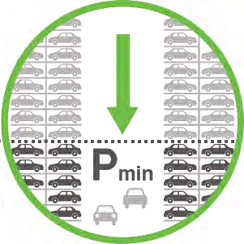
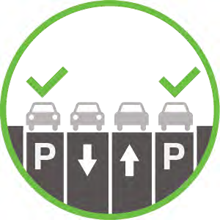
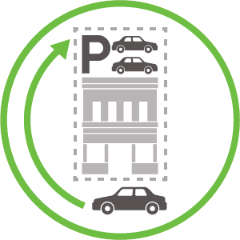
Parking Standards
Reduce (in some cases, eliminate) minimum on site requirements.
Allow on-street parking to count toward minimums.
Require on-site parking to be located behind the building.
Include bike parking, public transit facilities, and pedestrian connections in site plan standards.

Slide 9
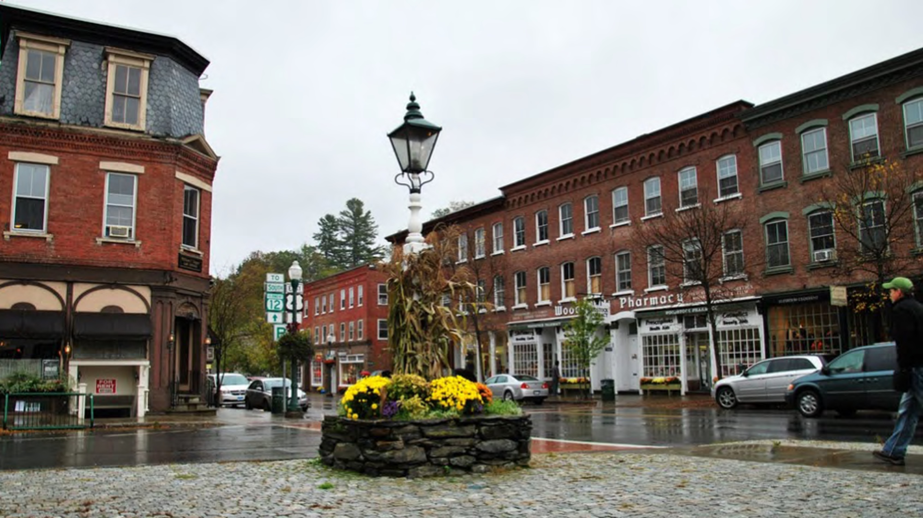
Street Standards
Reduce travel lane width.
Implement complete streets principles.
Provide connections between streets and developments.
Use appropriate standards for sidewalk width, street trees, use of outdoor space for public purposes.

Slide 10
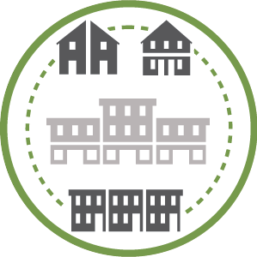
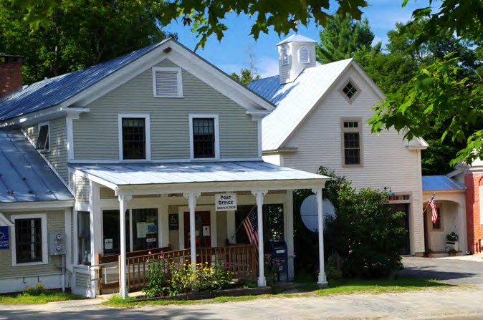


Allowable Uses
Expand housing choice, such as 3+ unit MF buildings in centers.
Encourage mixed uses and residential uses in village centers and downtowns.
Avoid artificial determination of family composition.

Slide 11


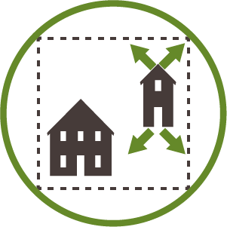
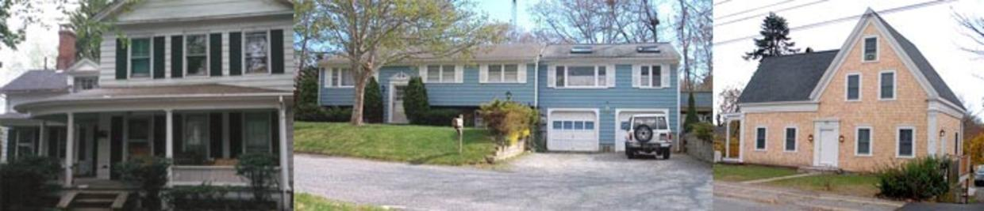
Accessory Dwelling Units [ADUs]
Allow the owner to occupy the ADU and rent out the principal building.
Increase the permissible area of ADU (% of the principal building or the size of an accessory building).

Slide 12

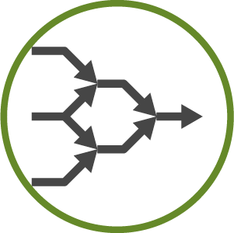

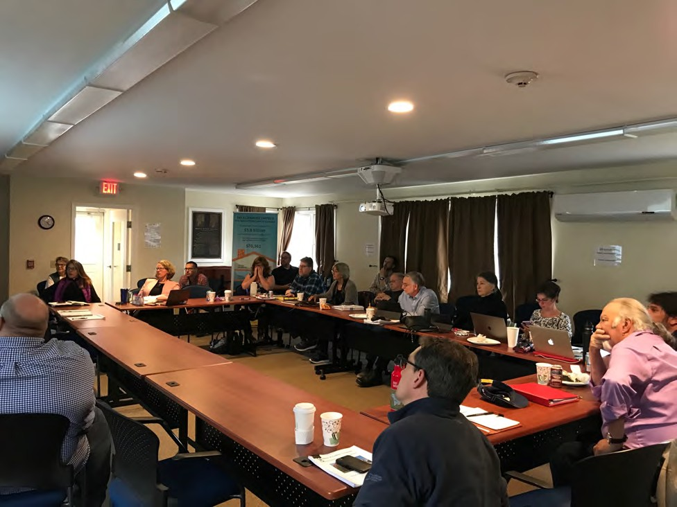
Development Review Process
Reduce conditional use and discretionary site plan approval requirements. Establish clear standards for permitted uses.
Simplify application requirements for small scale developments / permitted uses and staff-level review.
Define and permit limited deviations for specific reasons.
Avoid unnecessary site plan requirements and density calculations (e.g., slope restrictions).

Slide 13
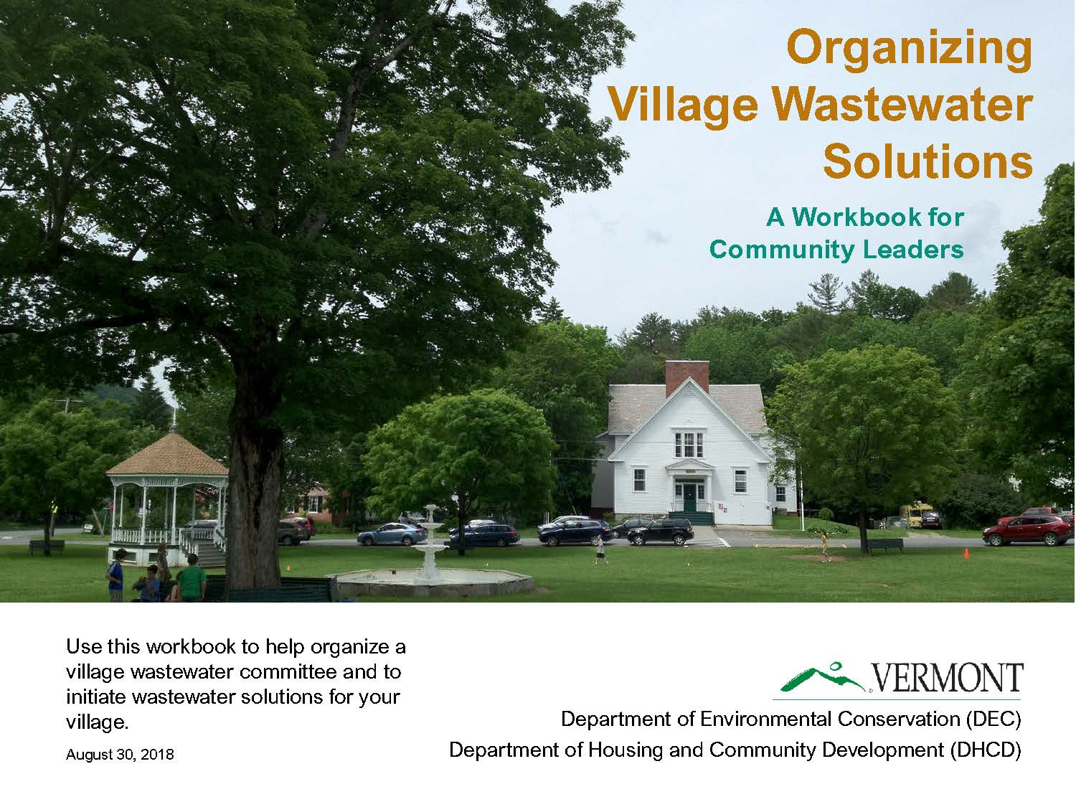
https://dec.vermont.gov/village-wastewater

Slide 14
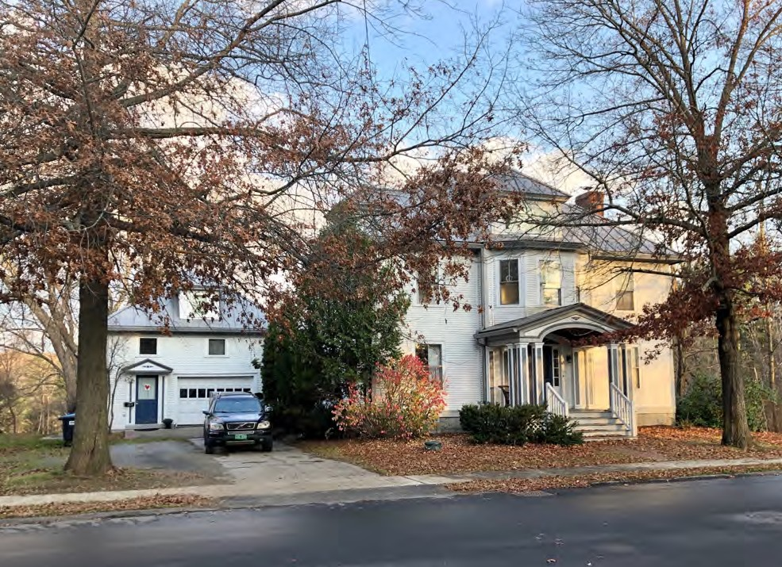
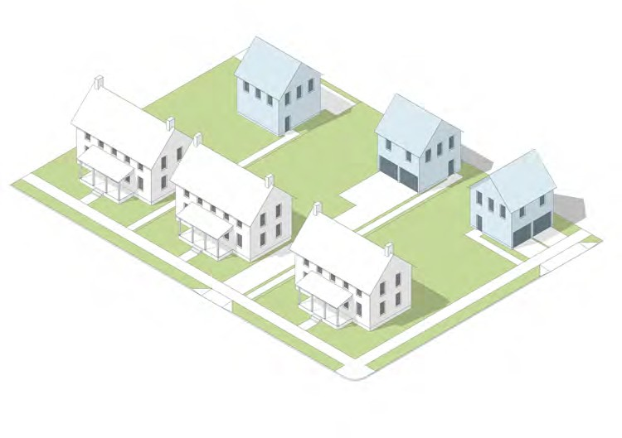
“Missing Middle" Residential Types
Accessory Dwellings
Montpelier, VT: Susan Henderson

Slide 15
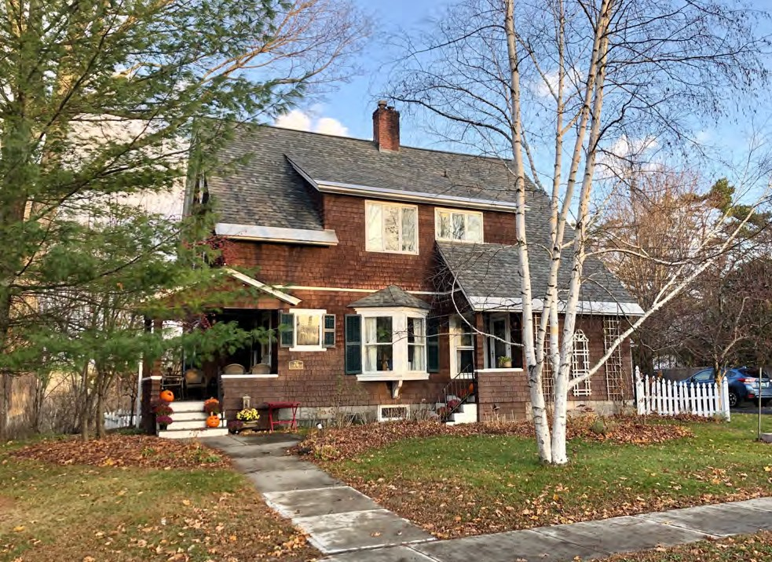
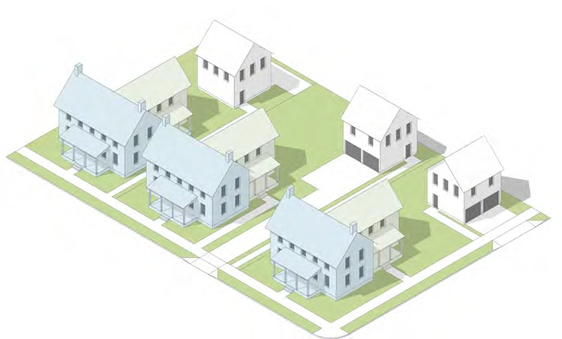
“Missing Middle" Residential Types
Duplex
Montpelier, VT: Susan Henderson

Slide 16
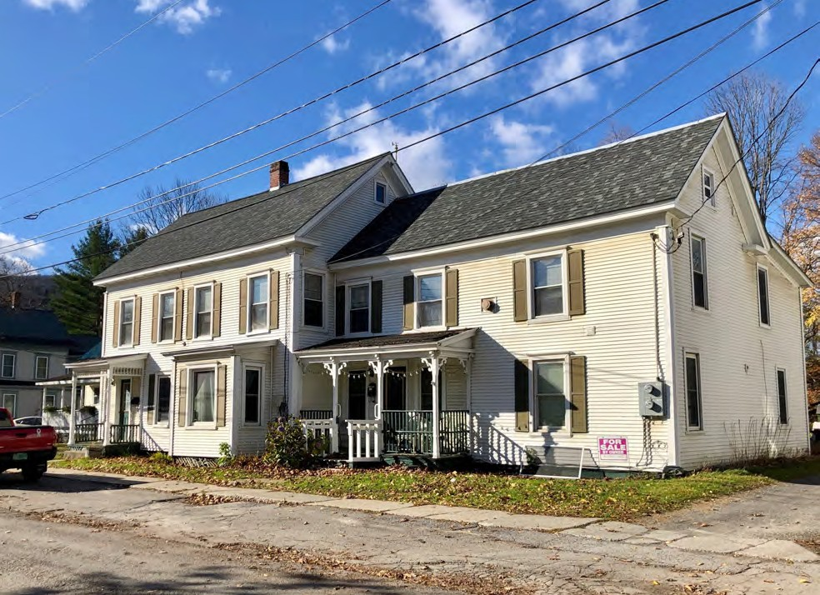
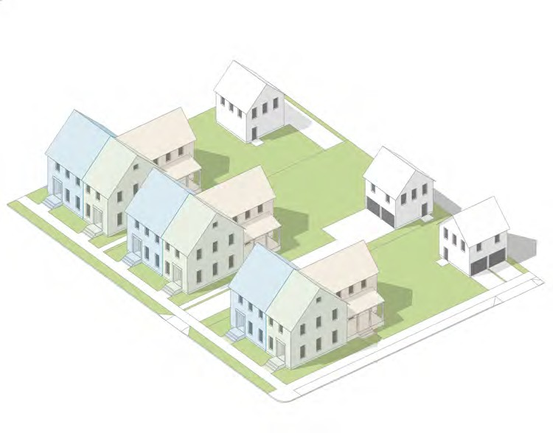
“Missing Middle" Residential Types
Triplex
Waterbury, VT: Susan Henderson

Slide 17
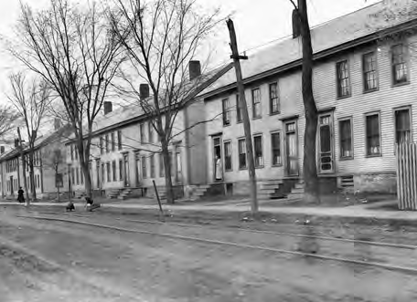
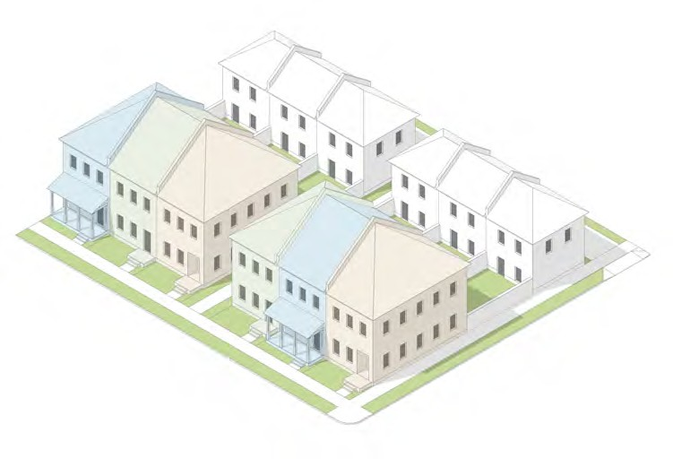
“Missing Middle" Residential Types
Townhouse
Bennington, VT: c1909, Lewis Hine

Slide 18
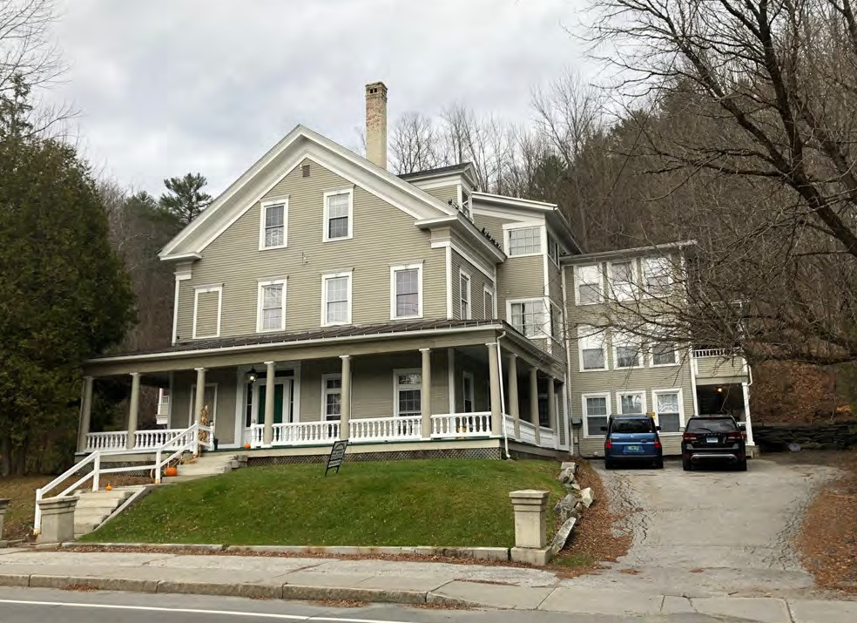
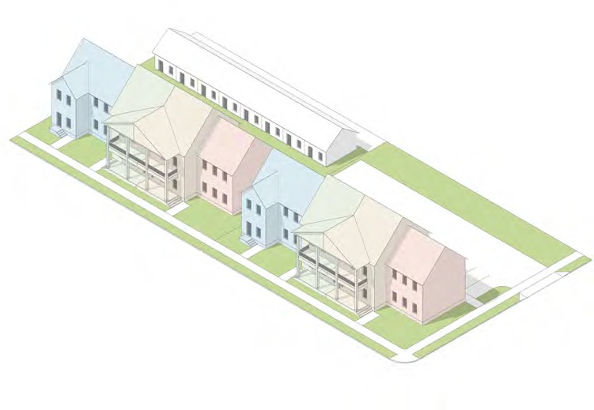
“Missing Middle" Residential Types
Multiunit
Montpelier, VT: Susan Henderson

Slide 19
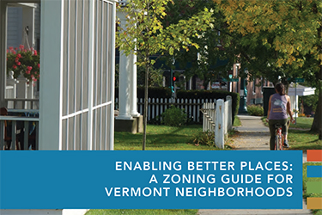
https://accd.vermont.gov/content/zoning-for-great-neighborhoods

